Slide 1
ANPR Automatic Number plate recognition
By – Chetan Panchal

Slide 2
Introduction
Number Plate Recognition (NPR) is a computer vision-based technology in which we capture the image of vehicle. After capturing the image of the vehicle we extract the number plate of a vehicle to identify the details of the owner of the vehicle. This project aims to design an efficient automatic authorized vehicle identification system by using the vehicle number plate.

Slide 3
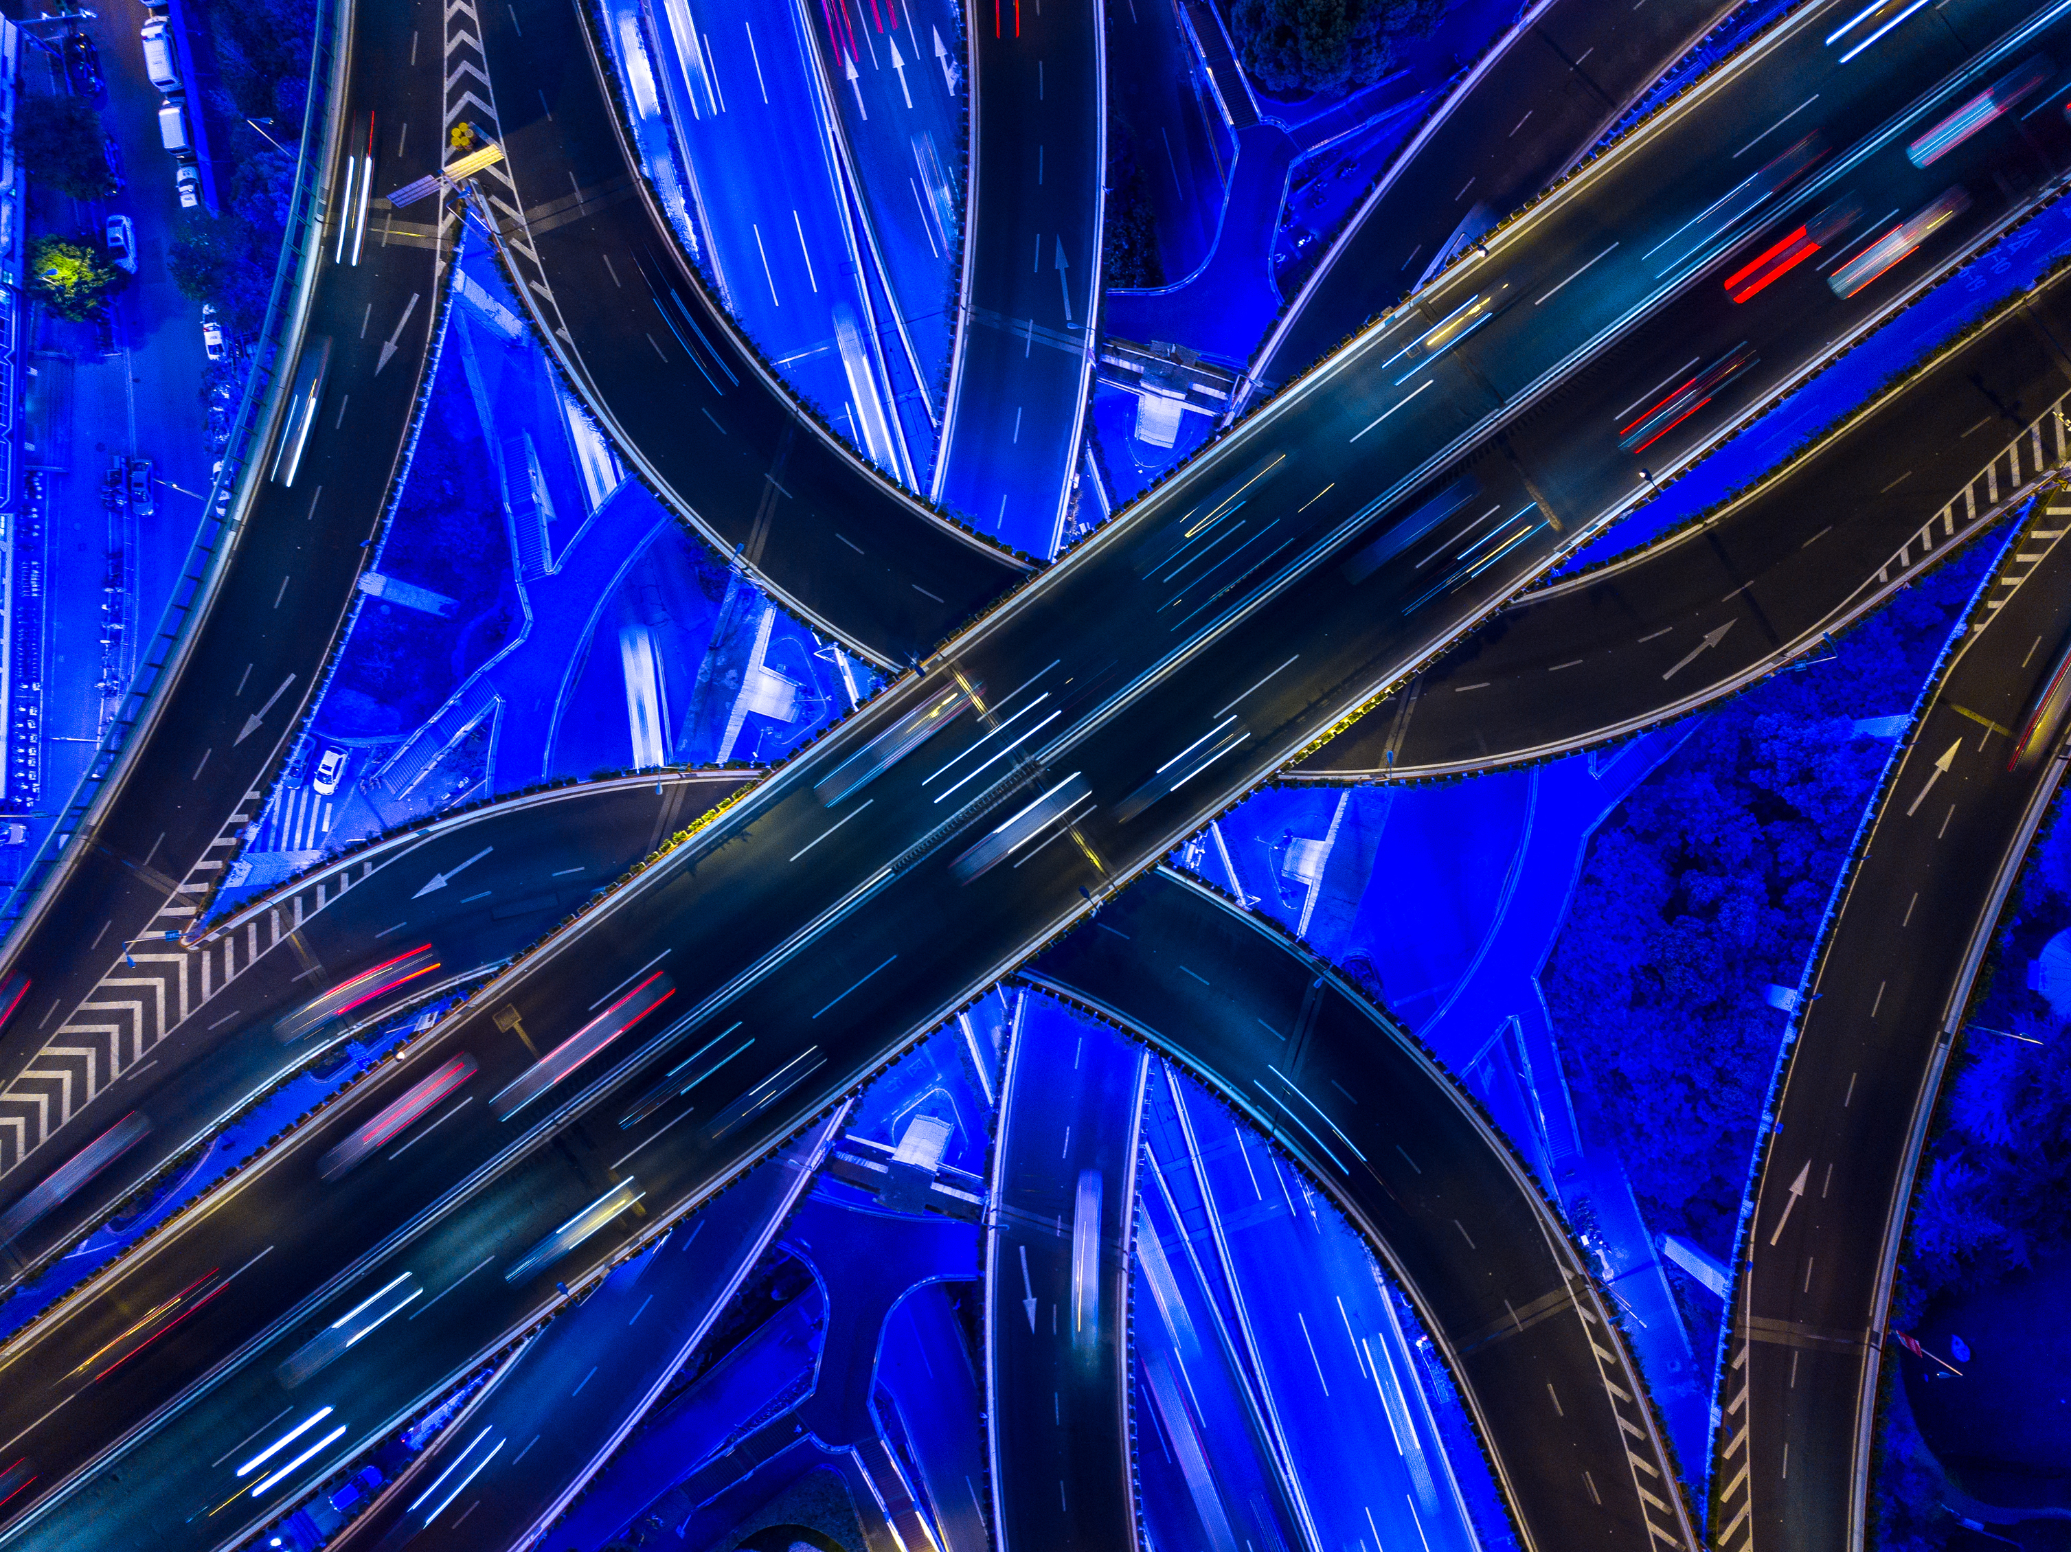
Requirements
Hardware Requirements :-
1) Camera
2) Computer
3) GPU (graphical Processing Unit)
Software Requirements :-
Number plate recognition software
Database
Pre-defined models for transfer learning

Slide 4

Working
Working of this system can be break down in five steps which are follows:-
Capturing of image from camera
Tracking vehicles using COCO (Common Objects in Context) model
Tracking License plate using pre-trained model on (YOLOv8n)
Pre processing of image
Reading the License plate no. using “easyocr”

Slide 5
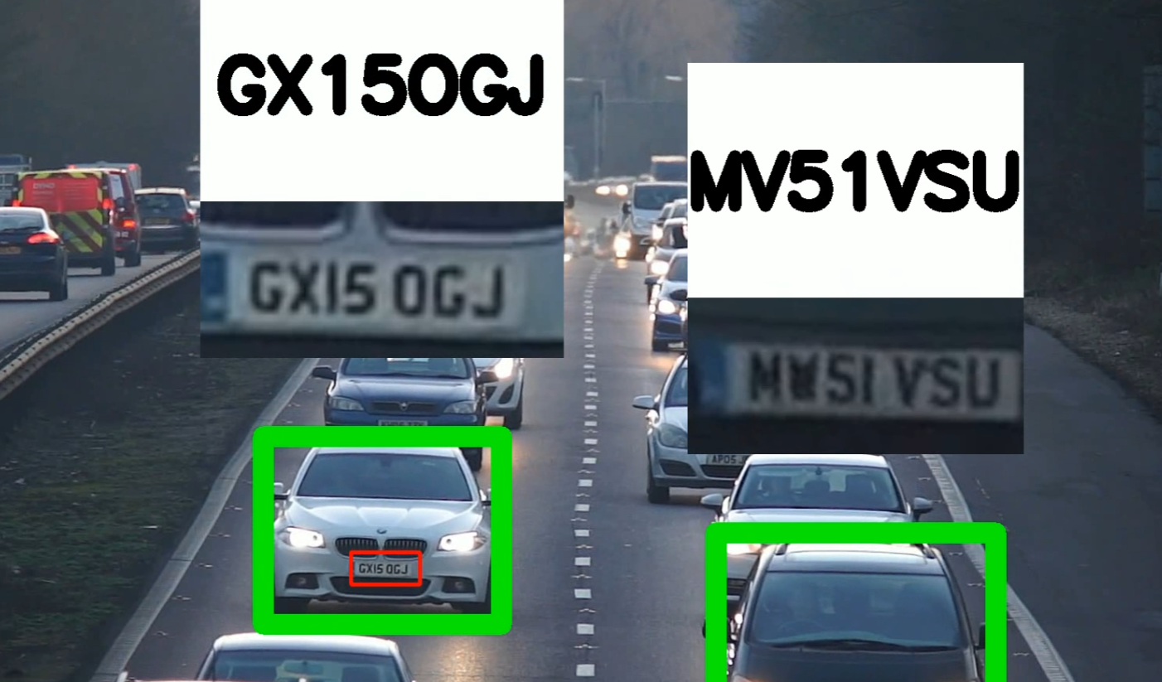
Architecture
Detection of the no. plate is done by YOLO algorithm
Source image
Detection of the vehicle is done by COCO model
Assign license plate to the car
Detects the region of the number plate
License plate detected
Not a license plate
Image Processing
License plate cropping
Extract the text using OCR
Text is filtered and displays character recognised

Slide 6
Similar solutions
1.RFID(Radio Frequency Identification):-
This technology could be a variety of wireless communication during which we have a tendency to use magnetic or electric coupling within the frequency portion of the spectrum to unambiguously establish an individual or object. This is a system that has primarily 2 components: 1. Tags and 2.Readers. 2

Slide 7
Future Scope
The number plate recognition system can be enhanced to record all types of number plates whatever their size and font type may be.
The woking of this model can be made faster as the technique which are implemented at this time are slow they usually take around more time to provide complete result.
Could detect the fake Number plate and take the image of the driver and store it in the Database.
Could detect the vehicle which run fast if they are breaking the traffic rules than we could put fine on the vehicle driver.
Implement a dynamic toll pricing system based on traffic density, time of day, and vehicle types.

Slide 8

Conclusion
In conclusion, the License Plate Recognition (LPR) project represents a significant advancement in the field of computer vision and automated systems. Throughout this project, I have developed a robust system capable of accurately detecting and recognizing license plates from vehicles in real-time.
References :-
OpenCV Documentation
YOLOv8 Documentation
COCO Documentation
SORT: A Simple Online and Realtime Tracking Algorithm
Python OpenCV Tutorial

Slide 9
THANK YOU

